Slide 1
Transport Management System
Name RollNo
Ajith Kumar 27 Sunil Kumar Yadav 51

Slide 2
Introduction
Hari Om Logistics is a company which does the process of planning, implementing, and controlling the efficient, effective flow and storage of goods, services, transport, and related information from point of origin to point of consumption for the purpose of conforming to customer requirements.

Slide 3
Existing system
There is no computerized provision in the company to maintain all the trip details that are taking within the company. All the customer order are being handled manually.
A customer has to come up to the company personally to book a vehicle or to send a parcel. All the order details are also being maintained manually.
The labor work is too much and no proper maintenance is taking place in the existing system.
A considerable amount of effort, time and resources are involved due to manual processing can be achieved.
No proper control over collection of data.

Slide 4
Scope
The logistics and transportation activities are moving towards the centre stage world around and becoming the most critical business function in today’s world of immense competition. Today, quickest and efficient supply chain management is the key success factor for many business sectors.

Slide 5
Software and Hardware Requirements :
Hardware:
Processor : Intel I3 or above.
Ram : 1 GB or above. HDD: 300GB or above.
Software :
Operating system : Windows 7 or above. Web Browser: Chrome , Mozila , Firefox ect. Development tools: HTML,JSP,ASP.
Database: Microsoft Access

Slide 6
Proposed System
The proposed system will record the order details as well as the customer details, and generate an appropriate Invoice to be presented to the Customer for order confirmation.
The appropriate transport facilities must be set. The proposed system displays all the vehicles information that are available for delivery. It then allows the Admin to select the vehicle and assign driver for the door delivery and records all the information

Slide 7
Module Specification
User Login & Registration.
Booking Vehicle & send parcel.
Managing Vehicle, Parcel, Drivers ,User.
Vehicles & Drivers update.

Slide 8
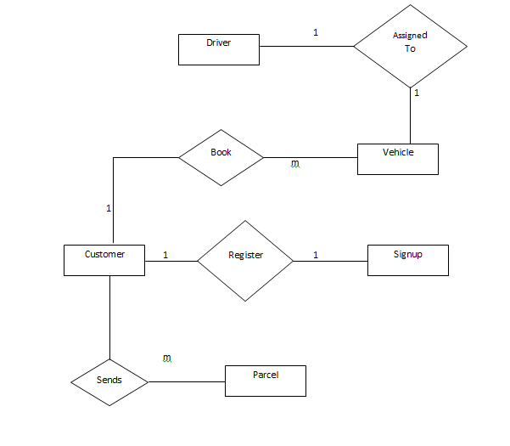
Entity Relationship Diagram:

Slide 9
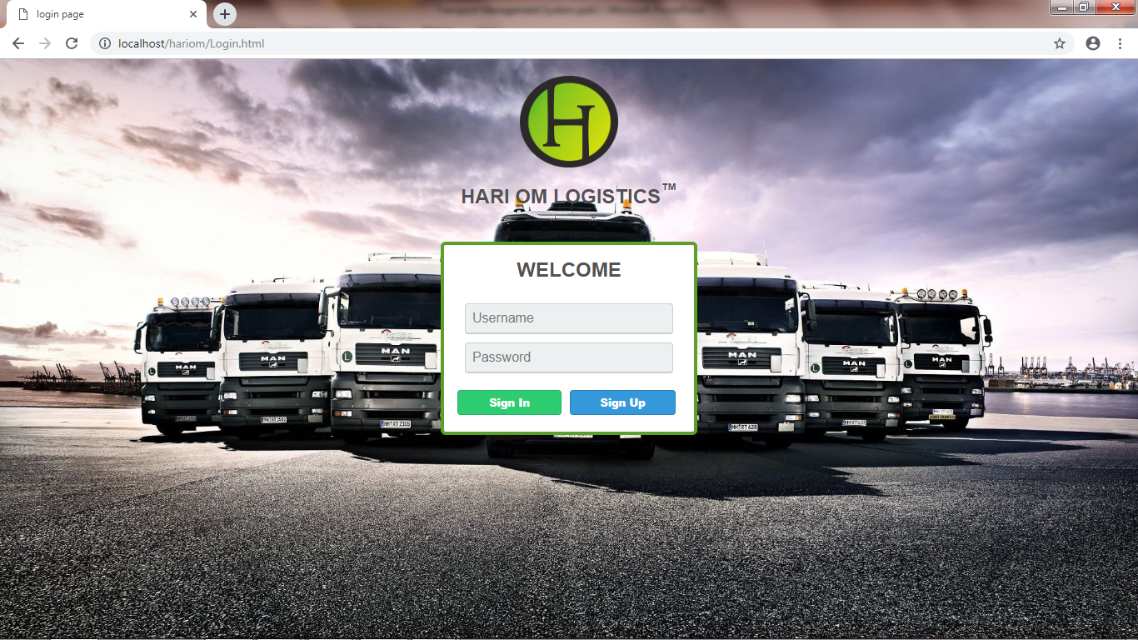
Log In form

Slide 10
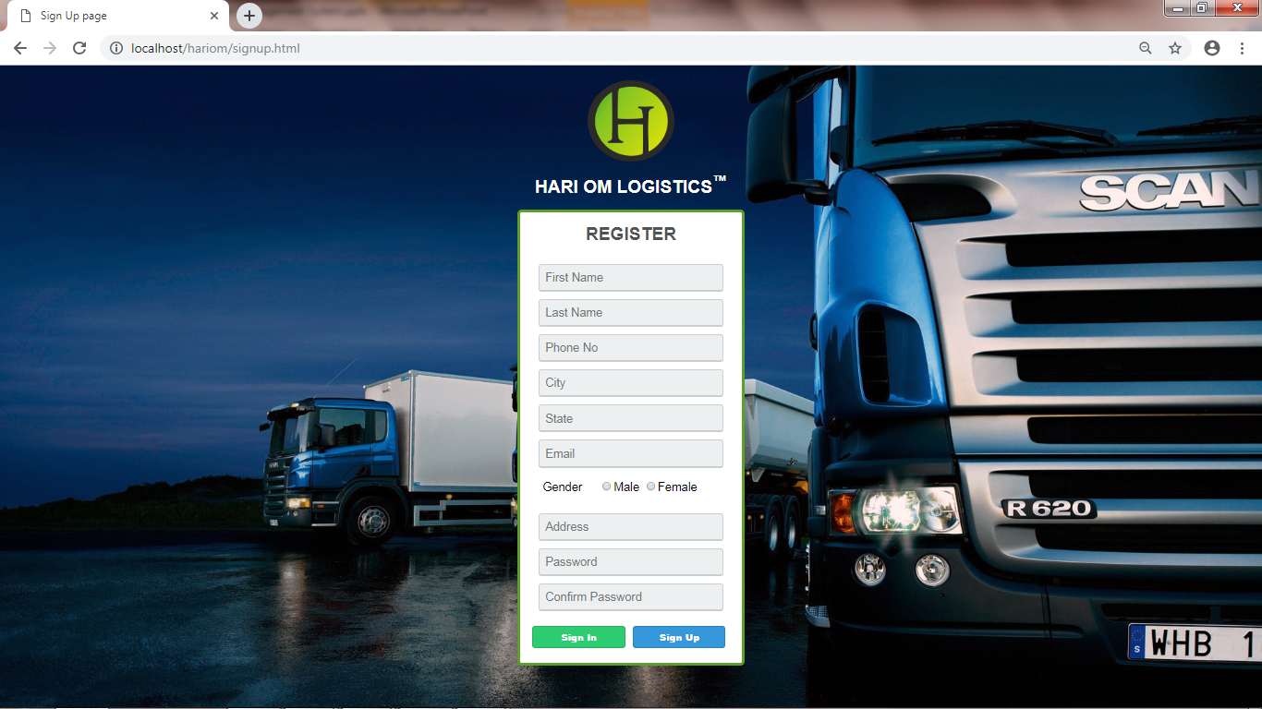
Registration form

Slide 11
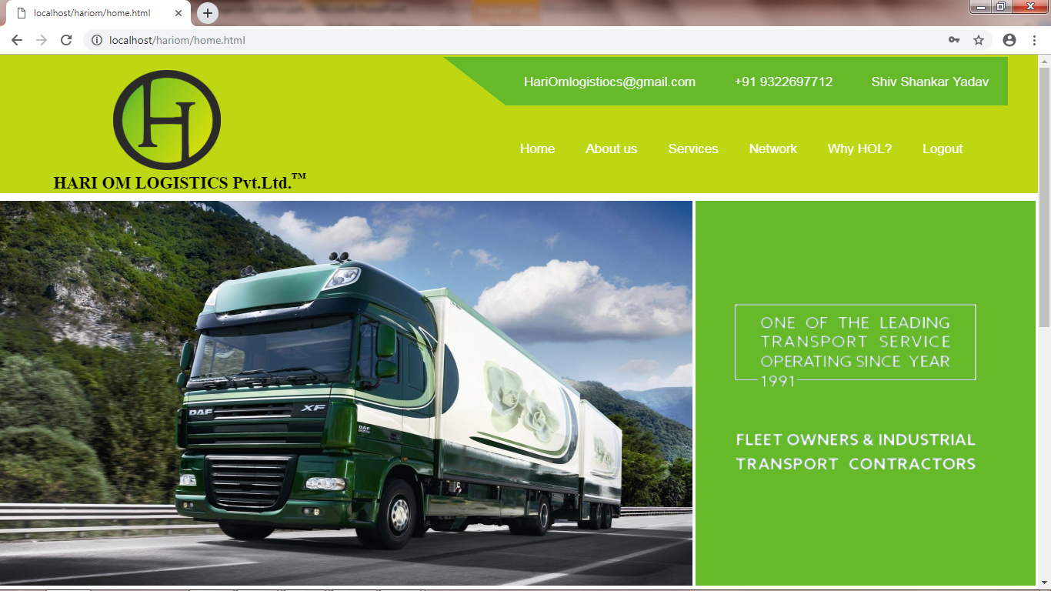
User Home Page

Slide 12
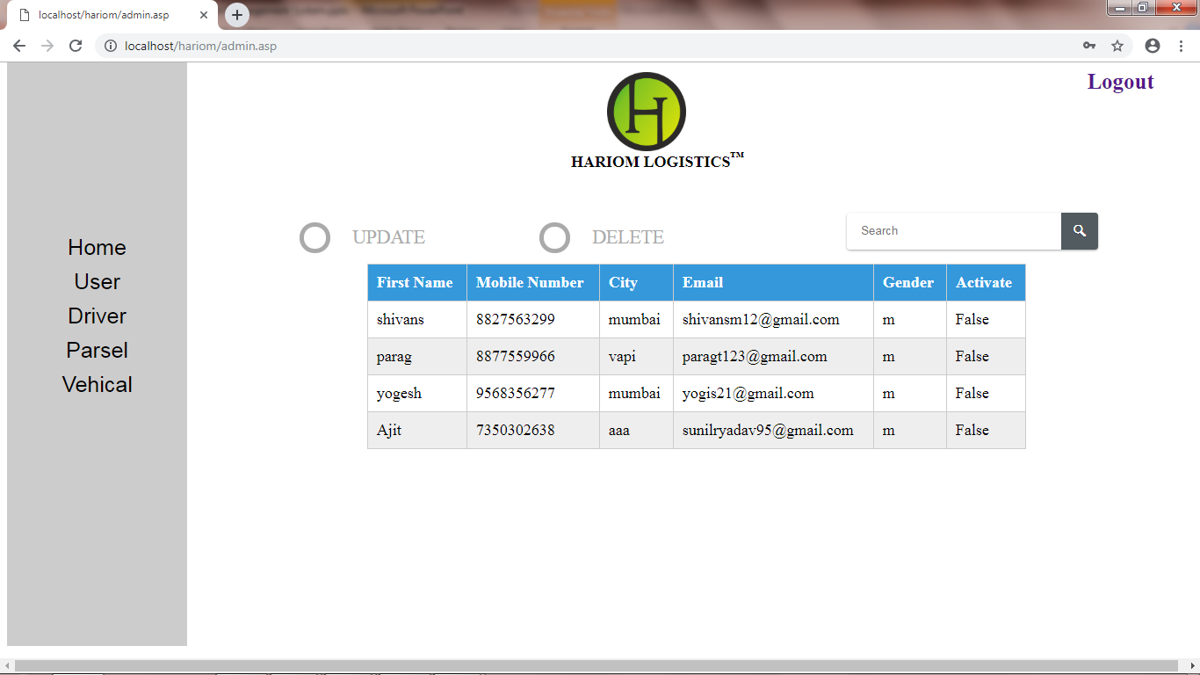
Admin Home Page

Slide 13
Reference
https://www.w3schools.com/css/default.asp
https://www.w3schools.com/js/default.asp
https://www.w3schools.com/html/default.asp
https://www.w3schools.com/asp/

